Slide 1
Models to Code Generation
Week-06
Fall - 2025
Subject: Software Construction & Development
Instructor: Mr. Sharif Hussain

Slide 2
Contents
Introduction to Model-Driven Engineering
Model Transformation Process
Model-to-Code Generation
Modeling Languages and Tools
Code Generation Techniques
Code Generation Workflow
Benefits of Model-to-Code Generation
Practical Examples and Case Studies

Slide 3
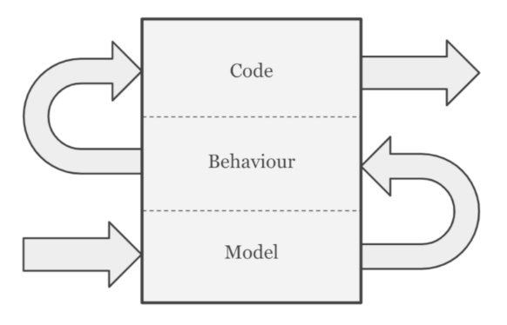
Model-Driven Engineering (MDE)
A software development approach that focuses on models as the primary artifacts, not code.
These models describe the system’s structure and behavior and are later transformed into executable code through automated tools, improving productivity and consistency.

Slide 4
Model Transformation Process
The Model Transformation Engine in MDE converts a Platform-Independent Model (PIM) into a Platform-Specific Model (PSM) through a Model-to-Model (M2M) transformation.
Example: A UML Class Diagram showing entities like Student, Course, and Registration (PIM) is transformed into a detailed structure with platform-specific elements such as data types or database mappings (PSM).

Slide 5
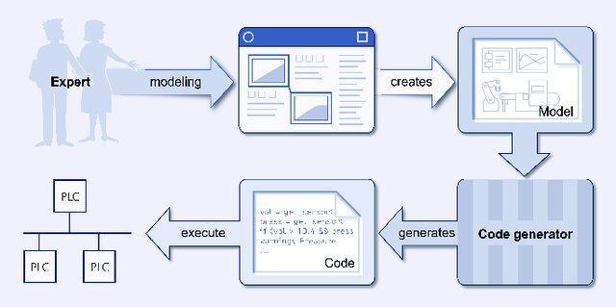
Models to Code Generation
Model-to-Code Generation is the most common and practical application of MDE. It is a Model-to-Text (M2T) transformation where models are converted into executable source code (like Java, Python, C++, or SQL).
It bridges design and coding using a tool called a code generator.

Slide 6
Modeling Languages and Tool
Modeling languages define rules for creating system models, while tools help design and manage them.
  GPL: UML — includes Class, Sequence, Activity, and State diagrams.
  DSL: Custom languages for specific domains, e.g., Java or SQL for databases.
  Tools: StarUML, Visual Paradigm, Enterprise Architect, draw.io.

Slide 7
Code Generation Techniques
Template-Based:
    Generates code from model templates.
    Example: UML Class → Student.java
    Tools: Visual Paradigm, StarUML, Acceleo
Model Interpretation:
    Runs/simulates the model directly without generating code.
    Example: State Machine Diagram of an elevator
    Tools: MATLAB/Simulink, IBM Rhapsody, AnyLogic

Slide 8
Code Generation Techniques (Cont.)
Hybrid Approach:
    Generates basic code, then manually adds custom logic.
    Example: UML → Java classes → add business logic
    Tools: Enterprise Architect, Eclipse EMF, Visual Paradigm + NetBeans

Slide 9
Code Generation Workflow
Create/Update Model: Use a tool (e.g., StarUML) to design or modify the model, like adding a new UML class.
Validate Model: Check the model for errors (e.g., missing class names).
Run Generator: Trigger code generation in the tool.

Slide 10
Code Generation Workflow (Cont.)
Generate Code: The engine applies templates and creates code files (e.g., Customer.java, Order.java).
Integrate Code: Add generated files to the project and write any additional manual code as needed.
Note: Always update the model first; do not edit generated code directly. The model is the “source of truth.”

Slide 11
Benefits of Model-to-Code Generation
Faster Development: Saves time by automating repetitive coding tasks.
Consistency: Reduces human errors; keeps design and implementation aligned.
Maintainability: Changes in models automatically update the code.
Documentation: Models serve as system documentation.
Productivity: Developers focus more on logic than syntax.

Slide 12
Practical Examples
Example 1 – Student Registration System:
UML Class Diagram → Generates Java classes (Student, Course, Registration).
Activity Diagram → Defines workflow of registration.
Code generated in NetBeans and linked with MySQL database.
Example 2 – Banking Application:
UML Sequence Diagrams used to define transaction flows.
Automatically generated backend service code.

Slide 13
Thanks
...?

Slide 14
Class Activity
Scenario:
A university system predicts student performance using attendance, assignments, and exams.
Tasks:
Draw a UML Class Diagram with Student, Teacher, PredictionModel, PerformanceRecord.
List 2 attributes and 1 method for each class.
Give your own unique name for the app and explain why you chose it.

